Slide 1
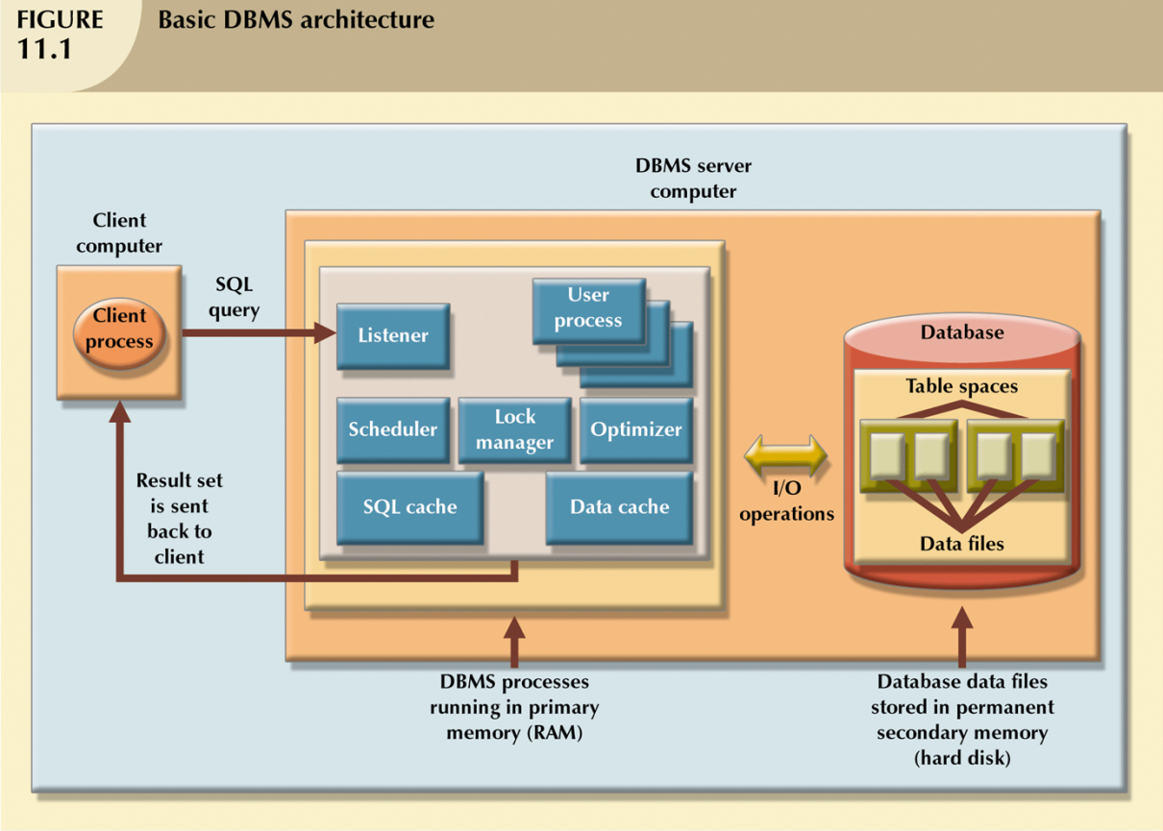
Query Optimization

Slide 2
Database Performance
for the small tables we use in class (< 100 rows) performance is never an issue
for large databases, with millions of records, writing efficient queries is essential
one aspect of query optimization is indexing

Slide 3
Indexes
indexes can be used to speed up
searching
sorting
aggregating data
joining data
an index scan is faster than a full table scan because the keys are sorted and the size is smaller

Slide 4
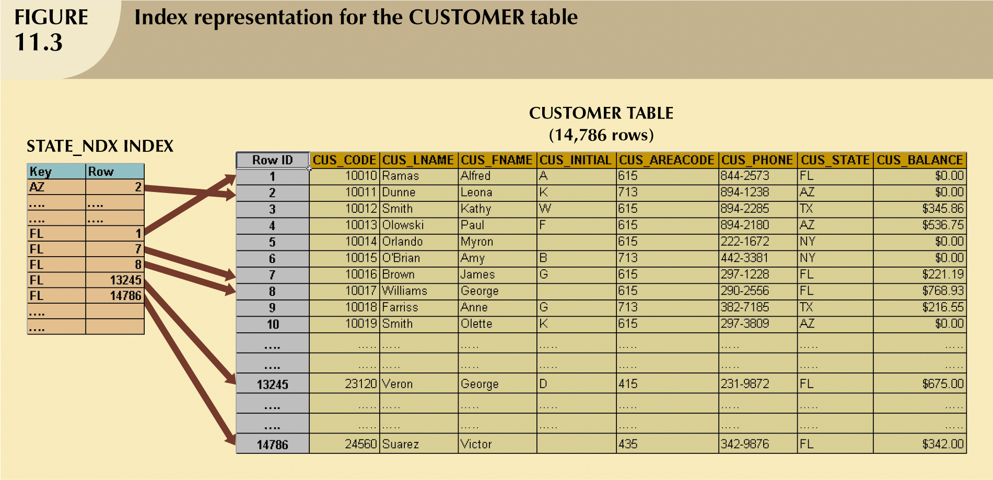
A Sample Index

Slide 5
Example
select cus_name, cus_state
from customer
where cus_state = ‘FL’;
without an index on state, a full table scan of all 14,786 rows will be performed

Slide 6
Example
with an index on state, the DBMS will find the first customer with state equal to ‘FL’ and then read the subsequent rows until the state changes to a different value
5 accesses to the index
5 accesses to the customer table

Slide 7
When to Index
for each insertion, and deletion, and for updates of indexed columns, the indexes must be updated
if there are too many indexes, index-maintenance will be prohibitive
for this reason, choose indexes carefully

Slide 8
When to Index
primary and foreign keys are usually indexed automatically by the DBMS
index columns that appear frequently as the only column in the search criteria for a WHERE or HAVING clause or in a GROUP BY or ORDER BY clause
columns with low data sparsity (very few distinct values, e.g. employee gender) are usually not indexed

Slide 9
Query Processing
while indexing is important, there are many other aspects to optimizing query performance

Slide 10
Factors in Performance
many factors affect database performance, including
CPU (speed and number of processors)
RAM (size)
hard disk (size and speed)
network (capacity; tuned for performance)
operating system (tuned for performance)
application (tuned for performance)

Slide 11
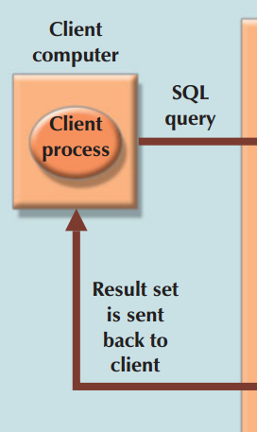
Steps in Query Processing
user (client) generates query
query sent to DBMS (the server)
DBMS executes the query
DBMS sends results back to user (client)

Slide 12
DBMS Architecture – Data Files
data are stored in data files
may contain rows from a single table or rows from several tables
the database administrator (DBA) determines the initial size of the data files
data files are physical structures that are dependent on the operating system in which Oracle is running

Slide 13
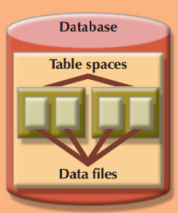
Table Spaces
data files are grouped in table spaces
a table space is a logical grouping of data files
a user table space is used to store all tables created by that user
a system table space can be used to store the data dictionary
a temporary table space can be used for tables created by temporary sorts, groupings, and so forth
Notes:
http://docs.oracle.com/cd/E11882_01/server.112/e25789/logical.htm
finest level of storage: data block (a specific number of bytes of physical disk space)
extent: a set of logically contiguous data blocks
segment: a set of extents allocated for a specific database object, such as a table. Every database object that consumes storage consists of a single segment. For example, the data for the employees table is stored in its own data segment; each index for employees is stored in its own index segment.
Each segment belongs to one and only one tablespace. So all extents for a segment are stored in the same tablespace. Within a tablespace, a segment can include extents from multiple data files. For example, one extent for a segment may be stored in user01.dbf, while another is stored in user02.dbf. A single extent can never span data files.

Slide 14

Data Cache (Buffer Cache)
the data cache (or buffer cache) is shared memory that stores the most recently accessed data blocks in RAM
stores the data after it has been read or before it is written

Slide 15

SQL Cache
the SQL cache is shared memory that stores the most recently executed SQL statements or procedures, including triggers and functions
the SQL cache does not store the original SQL
instead it stores a processed version of the SQL that is ready for immediate execution

Slide 16
DBMS Processes
in addition to the components described above, many other processes run on the DBMS server, including
listener (listens for client requests)
user (a process is created for each user)
scheduler (schedules concurrent transactions)
lock manager (manages all locks on database objects)
optimizer (optimizes SQL queries)

Slide 17

DBMS Architecture

Slide 18
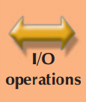
I/O Activity
data used by client must be retrieved from hard disk and moved to data cache
this requires an I/O request
normally an entire physical disk block is moved
working with data in the data cache is much faster than working in the data files

Slide 19
I/O Activity
performance-tuning activities focus on the number of I/O operations
RAM access times range from 5 to 70 nanoseconds
hard disk access times range from 5 to 15 milliseconds
ratio of fastest RAM access to fastest hard disk access ?
Notes:
Fastest RAM is 5 nanoseconds access time: Each access requires 5/1,000,000,000 of a second.
Fastest hard disk access time is 5 milliseconds: Each access requires 5/1,000 of a second.
RAM access time / hard disk access time = (5/1,000,000,000 ) / (5/1,000)
= 1/ 1,000,000;
So time for 1 hard disk access = 1,000,000 * time for one RAM access

Slide 20
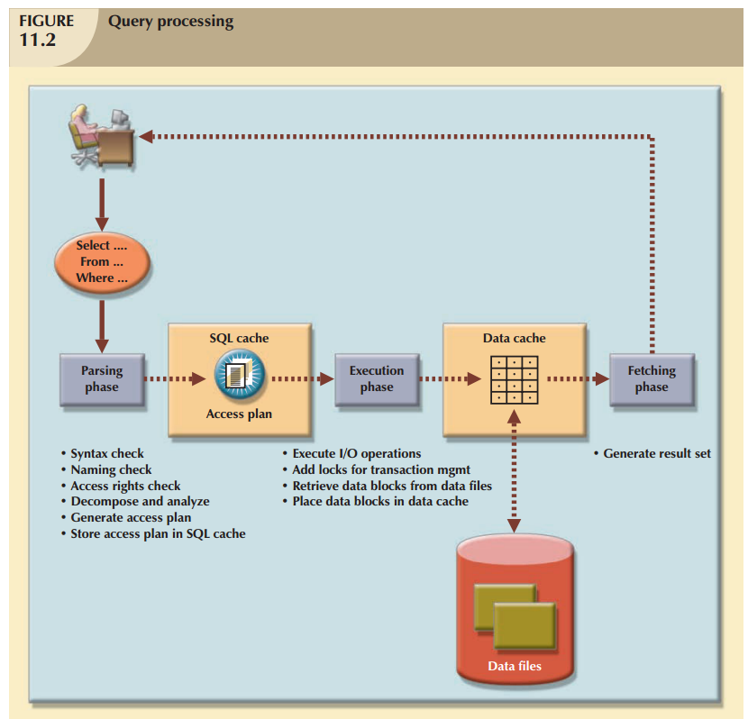
Query Processing
query processing is done in three stages:
parsing
execution
fetching

Slide 21
SQL Parsing Phase
parsing activities are performed by the query optimizer and include:
validating syntax of the query
validating names of tables and columns
validating the user’s privileges
decomposing into smaller units
transforming to fully equivalent but more efficient query
determining the most efficient access plan

Slide 22
Access Plans
an access plan is the series of steps the DBMS will use to execute the query
if an access plan for the query already exists in the SQL cache, it is used
otherwise, the new access plan is stored in the cache

Slide 23
SQL Execution and Fetch Phases
in the execution and fetch phases, all I/O operations specified in the access plan are executed
locks acquired, if necessary
data is retrieved from data files and placed in data cache
rows that match the conditions are retrieved, sorted, grouped, aggregated and returned to client

Slide 24
SQL Execution and Fetch Phases
the line between the execution and fetch phases is fuzzy
for more information, see
http://asktom.oracle.com/pls/asktom/f?p=100:11:0::::P11_QUESTION_ID:1855700000346846274

Slide 25
Access Plans
we will focus on the parsing phase
in particular, we will look at access plans
in order to determine which access plan is optimal, we need to decide how we are going to evaluate our access plans

Slide 26
Optimizer Choices
rule-based optimizer: this approach uses preset fixed-cost values for each SQL operation (full table scan, table access by row ID, sorting, etc.)
the cost of each operation is determined based on the preset values, then added together to determine the total cost of the query
the access plan with the lowest cost “wins”

Slide 27
Optimizer Choices
cost-based optimizer: uses sophisticated algorithms based on the statistics about the objects being accessed
includes processing cost, I/O cost, resource costs (RAM and temporary space, for example)
we will look at rule-based optimizers

Slide 28
Example
suppose we want to execute the following query:
select p_code, p_desc, p_price, v_name, v_state
from product, vendor
where product.v_code = vendor.v_code
and vendor.v_state = ‘FL’;

Slide 29
Example
We will develop two access plans for the query.
Then, compare the cost of each to see which access plan is optimal.

Slide 30
Example
assume there are no indexes
consider only the number of row reads required
assume a simple rule that each row read has an I/O cost = 1

Slide 31
Example
assume the PRODUCT table has 7,000 rows
the VENDOR table has 300 rows
ten vendors are located in Florida
1,000 products come from vendors in Florida
each product has exactly one vendor

Slide 32
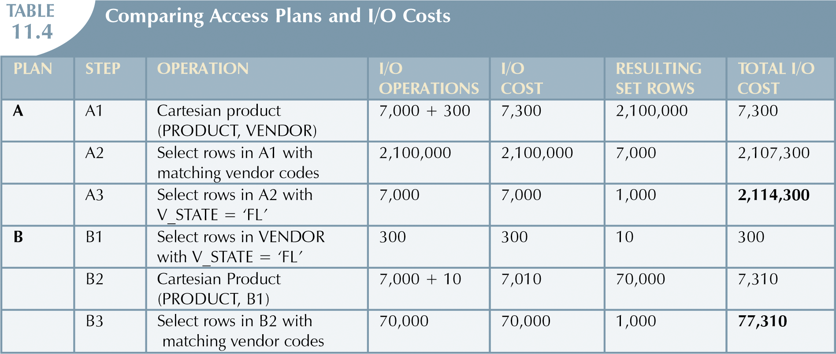
Comparing 2 access plans

Slide 33
SQL Performance Tuning Hints
use indexes judiciously
for conditional criteria
use literals where possible (price > 10 is faster than price > min * 1.1.0)
avoid functions if possible (use name = ‘Jim’ rather than upper(name) = ‘JIM’ if either one will work)
remember that comparing numeric data is faster than comparing character, date, or null values

Slide 34
SQL Performance Tuning Hints
use equality comparisons, instead of inequality comparisons, when possible
LIKE with wildcards is the slowest of all
when using multiple conditions, write equality conditions first
with multiple AND conditions, write the condition most likely to be false first
with multiple OR conditions, put the condition most likely to be true first

Slide 35
SQL Performance Tuning Hints
avoid NOT when possible (write emp_sex = ‘F’ rather than not(emp_sex = ‘M’)
most importantly, remember that these rules do not work for all DBMSs; you must know how your DBMS processes queries and then apply appropriate rules

Slide 36

Query Optimization
The End

